Slide 1
SELLING YOUR HOUSE
THINGS TO CONSIDER WHEN
SUMMER 2021
EDITION

Slide 2
TABLE OF CONTENTS
3
Why You Shouldn’t Wait To Sell Your House
Expert Insights on the Current Housing Market
Will Home Prices Continue To Rise?
Leveraging Your Equity To Make a Move
Why People Are Moving This Season
Should I Renovate My House Before I Sell It?
If I Sell Now, Where Will I Go?
When It Comes To Selling a House, Your Time Is Money
How Agents Leverage Today’s Technology
How To Prepare Your House for a Winning Sale
Why Pricing Your House Right Matters
Reasons To Hire a Real Estate Professional
5
6
8
10
12
13
15
16
17
18
19
2

Slide 3
Why You Shouldn’t Wait To Sell Your House
We’re in the ultimate sellers’ market right now. If you’re a homeowner thinking about selling, you have a huge advantage in today’s housing market. High buyer demand paired with very few houses for sale makes this the optimal time to sell for those who are ready. Whatever the move you want to make looks like, here’s an overview of what’s creating the prime opportunity to sell this summer.
High Buyer Demand
Demand is strong right now, and buyers are active in the market. In the Realtors Confidence Index Survey published monthly by the National Association of Realtors (NAR), buyer traffic is considered “very strong” in almost every state. Homebuyers aren’t just great in number right now – they’re also determined to find their dream home. NAR shows the average home for sale today is receiving five offers from hopeful buyers. These increasingly frequent bidding wars can drive up the price of your house, which is why high demand from competitive homebuyers is such a win for this summer’s sellers.
Low Inventory of Houses for Sale
Purchaser demand is so high, the market is running out of available homes to buy. Danielle Hale, Chief Economist at realtor.com, explains:
“For most sellers listing sooner rather than later could really pay off with less competition from other sellers and potentially a higher sales price . . . . They’ll also avoid some big unknowns lurking later in the year, namely another possible surge in COVID cases, rising interest rates and the potential for more sellers to enter the market.”
3
Notes:
https://cdn.nar.realtor/sites/default/files/documents/REALTOR_Confidence_Index_052021.pdf
https://money.com/covid-housing-shortage-timeline-sellers/

Slide 4
The National Association of Realtors (NAR) also reveals that unsold inventory sits at a 2.4-months’ supply at the current sales pace. This is far lower than the historical norm of a 6.0 months’ supply. Homes are essentially selling as fast as they’re hitting the market. Below is a graph of the existing inventory of single-family homes for sale:
At the same time, homebuilders are increasing construction this year, but they can’t keep up with growing demand. While reporting on inventory of newly constructed homes, the U.S. Census Bureau notes:
“The seasonally‐adjusted estimate of new houses for sale at the end of April was 316,000. This represents a supply of 4.4 months at the current sales rate.”
What Does This Mean for You?
If you’re thinking of putting your house on the market, don’t wait. A seller will always negotiate the best deal when demand is high and supply is low. That’s exactly what’s happening in the real estate market today.
As vaccine rollouts progress and we continue to see the economy recover, more houses will come to the market. Don’t wait for the competition in your neighborhood to increase. If you’re ready to make a move, now is the time to sell.
Bottom Line
Let’s connect today to get your house listed at this optimal moment in time.
Inventory Levels: Single-Family Homes
NAR
4
Notes:
https://www.nar.realtor/research-and-statistics/housing-statistics/existing-home-sales
https://cdn.nar.realtor/sites/default/files/documents/ehs-04-2021-single-family-only-2021-05-21.pdf
https://www.census.gov/construction/nrs/pdf/newressales.pdf

Slide 5
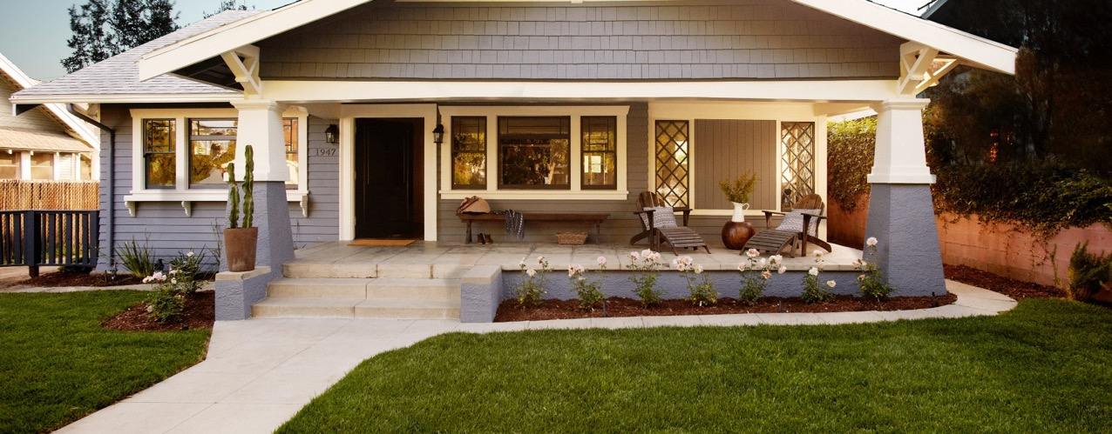
Expert Insights on the Current Housing Market
Real estate experts agree that the strength of today’s housing market isn’t going away anytime soon. Here’s what several industry leaders have to say:
George Ratiu, Senior Economist at realtor.com
“. . . as pandemic restrictions are lifted, more sellers are putting their homes on the market. Price growth remains strong, but the pace shows early signs of moderation as we move toward summer.”
The National Association of Realtors (NAR)
“Supply will remain tight given the huge gap between a desired 6 months of inventory of homes on the market compared to the current… Sellers who have been hesitant to list homes as part of their personal health safety precautions may be more encouraged to list and show their homes with a population mostly vaccinated by the mid-year.”
Freddie Mac
“We forecast that mortgage rates will continue to rise through the end of next year. We estimate the 30-year fixed mortgage rate will average 3.4% in the fourth quarter of 2021, rising to 3.8% in the fourth quarter of 2022.”
Lawrence Yun, Chief Economist at NAR
"With more inventory and some easing in demand, home prices are expected to shift to mid-single-digit appreciation by the fourth quarter and in 2022."
With buyers staying active this summer, sellers who want to close a deal on the best possible terms shouldn’t wait to put their houses on the market.
Bottom Line
Experts agree, the summer housing market is going to be a hot one. Let’s connect today so you can get in on the action and move into your dream home this year.
5
Notes:
https://www.realtor.com/research/video-weekly-economic-and-housing-market-update-may-28-2021/
https://www.nar.realtor/blogs/economists-outlook/how-are-buyers-coping-in-a-highly-competitive-housing-market
http://www.freddiemac.com/research/forecast/20210414_quarterly_economic_forecast.page?
https://money.com/coronavirus-spring-home-buying-outlook-tips/

Slide 6
Will Home Prices Continue To Rise?
According to the latest CoreLogic Home Price Insights Report, nationwide, home values increased by 11.3% over the last 12 months. The dramatic rise happened when the inventory of houses for sale reached historic lows at the same time buyer demand skyrocketed as a result of record-low mortgage rates.
Where will home values go from here?
Home price appreciation will continue to be determined by an imbalance of supply and demand. If supply remains low and demand high, prices will continue to increase, making it a great time to sell your house.
Housing Supply
Danielle Hale, Chief Economist at realtor.com, explains:
“In many areas of the country, there are half as many available homes for sale than a year ago — and in some markets that number increases to less than one third… For a buyer, that means if they had 10 homes in their price range to choose from last year, they have less than five, perhaps as few as three, available to them today.”
However, there are two reasons driving speculation that the inventory shortage will ease somewhat as we move through the year:
1. As the health crisis subsides, more homeowners will be comfortable putting their houses on the market.
2. Some households impacted financially by the pandemic will be forced to sell.
6
Notes:
https://www.corelogic.com/insights-download/home-price-index.aspx
https://money.com/covid-housing-shortage-timeline-sellers/

Slide 7
Housing Demand
In addition, low mortgage rates have powered buyer demand for a year now. While rates have risen slightly and are projected to continue rising this year, they’re still much lower than the historical norm. Low rates create a great opportunity for homebuyers, which is one reason why demand is expected to remain high throughout the year.
Taking into consideration the projections on housing supply and demand, real estate analysts forecast home prices will continue to appreciate through 2022. Here are their forecasts:
Bottom Line
There’s still a very limited number of homes for sale compared to the demand from purchasers looking to buy them. As a result, home values will continue to appreciate, making this summer a fantastic time to sell your current house.
2021 Home Price Forecasts
7.1% Average of All Forecasts
7
Notes:
https://www.mba.org/news-research-and-resources/research-and-economics/forecasts-and-commentary
https://www.fanniemae.com/media/38961/display
https://www.zelmanassociates.com/ (suscription required)
https://cdn.nar.realtor/sites/default/files/documents/2021-05-13-realtors-legislative-meetings-residential-economic-issues-and-trends-forum-lawrence-yun-presentation-slides-05-13-2021.pdf
http://www.freddiemac.com/research/forecast/20210414_quarterly_economic_forecast.page?
https://www.realtor.com/research/2021-national-housing-forecast/
https://www.corelogic.com/insights-download/home-price-index.aspx

Slide 8
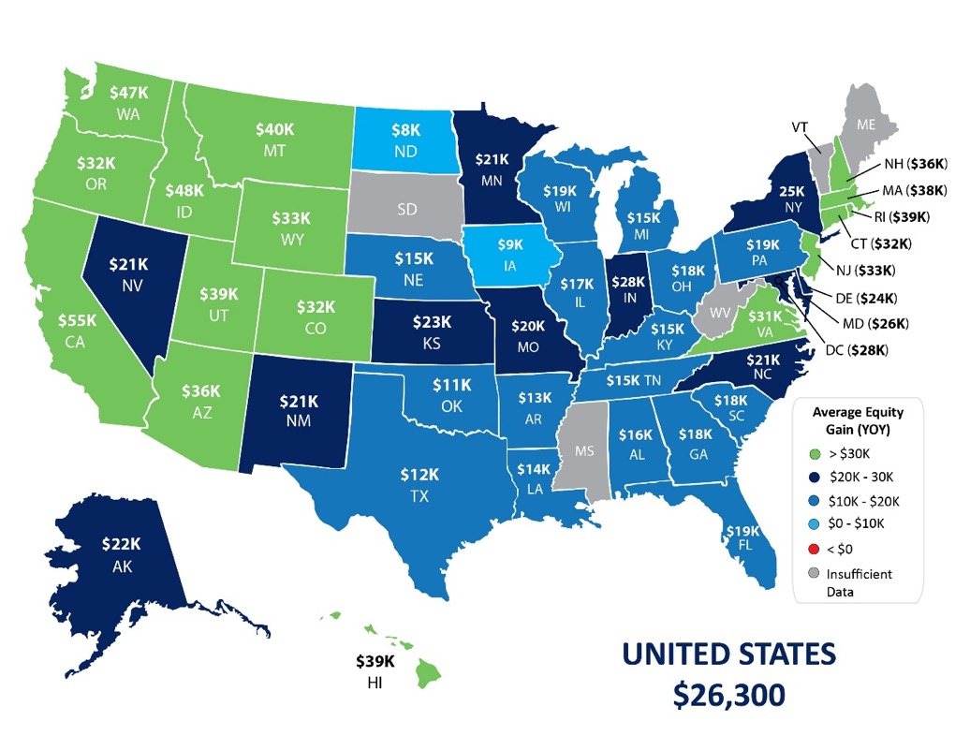
Leveraging Your Equity To Make a Move
According to the latest data from CoreLogic, the average homeowner gained $26,300 in equity in 2020, and that number continues to grow as home values appreciate.
With equity growing so significantly, you’re likely in a strong position to sell this year. Your current home equity can be put to work for you to accomplish big goals like affording a larger down payment on your next home.
Homeowner Equity Gains over the Last Year
CoreLogic
8
Notes:
https://www.corelogic.com/insights-download/homeowner-equity-report.aspx

Slide 9
The graph below is a great example of how home price appreciation can work in your favor. If you purchased a $350,000 home in January of this year, based on projected home price appreciation, you could potentially gain an expected $82,338 in equity over the next 5 years – just by being a homeowner.
So, if you’re thinking of moving, remember that as a homeowner, you may have more equity in your house than you realize. Using it to make a move to a new home while interest rates are still low may be the best decision you could make.
Mark Fleming, Chief Economist at First American, notes:
“Existing homeowners today are sitting on record amounts of equity. As homeowners gain equity in their homes, the temptation grows to list their current home for sale and use the equity to purchase a larger or more attractive home.”
Bottom Line
Whether you’re ready to move up into a larger home or downsize into a smaller one, let’s connect to see if your current home equity positions you to make your next move sooner than you may have thought possible.
$82,338
Potential growth in household wealth over the next five years based solely on increased home equity, if you purchased a $350K home in January 2021
Based on price appreciation as projected by the Home Price Expectation Survey
Home Price Expectation Survey 2021 1Q
9
Notes:
https://pulsenomics.com/surveys/#home-price-expectations
https://blog.firstam.com/economics/the-good-the-bad-and-the-maybe-ahead-of-spring-home-buying?

Slide 10
Why People Are Moving This Season
Today, Americans are moving for a variety of reasons. The health crisis has truly reshaped our lifestyles and our needs. Spending so much more time in our current homes has driven many people to re-evaluate what homeownership means and what they find most valuable in their living spaces.
According to the 2020 Annual National Movers Study:
“For customers who cited COVID-19 as an influence on their move in 2020, the top reasons associated with COVID-19 were concerns for personal and family health and wellbeing (60%); desires to be closer to family (59%); 57% moved due to changes in employment status or work arrangement (including the ability to work remotely); and 53% desired a lifestyle change or improvement of quality of life.”
With a new perspective on homeownership, here are some of the reasons people are reconsidering where they live and making moves this season.
1. Working from Home
Remote work became the new norm last year, and for some, it’s persisting longer than they initially expected. Many in the workforce today are discovering they don’t need to live so close to the office anymore and they can get more for their money by moving a little further outside the city limits. Apartment List notes:
“The COVID pandemic has sparked a rebound in residential migration: survey data suggest that 16 percent of American workers moved between April 2020 and April 2021, up from 14 percent in 2019 and the first increase in migration in over a decade… One of the major drivers in this trend is remote work, which expanded greatly in response to COVID and will remain prevalent even after the pandemic wanes. No longer tethered to a physical job site, remote workers were 53 percent more likely to move this past year than on-site workers.”
If you’ve tried to convert your guest room or your dining room into a home office with minimal success, it may be time to find a larger home. The reality is, your current house may not be optimally designed for this kind of space, making remote work very challenging.
10
Notes:
https://www.unitedvanlines.com/newsroom/movers-study-2020
https://www.apartmentlist.com/research/remote-work-wealthy-americans-moving-again

Slide 11
2. Room for Fitness & Activities
Staying healthy and active is a top priority for many Americans, and dreams of having space for a home gym are growing stronger. A recent survey of 4,538 active adults from 122 countries noted the three fastest-growing fitness trends amongst active adults:
At-home fitness equipment (up 50%)
Personal trainers/nutritionists (up 48%)
Online fitness courses, classes, and subscriptions (up 17%)
Having room to maintain a healthy lifestyle at home – physically and mentally – may prompt you to consider a new place to live that includes space for at-home workouts, hobbies, and activities for your household.
3. Outdoor Space
Better Homes & Gardens recently released the outdoor living trends for this year, and three of them are:
Outdoor Kitchens: 60% of homeowners are looking to add outdoor kitchens.
Edible Garden: Millions of people began gardening during the pandemic . . . to supplement pantries with homegrown fruits, vegetables, and herbs.
Secluded Spaces: As outdoor activity increases, so does the need for privacy.
You may not, however, have the extra square footage in your home today to have these designated areas – inside or out.
Bottom Line
If you’re clamoring for more room to accommodate your changing needs, making a move may be your best bet, especially while you can take advantage of today’s low mortgage rates. It’s a great time to get more home for your money, just when you need it most.
11
Notes:
https://runrepeat.com/fitness-trends
https://www.bhg.com/home-improvement/porch/outdoor-rooms/2021-outdoor-living-trends/

Slide 12
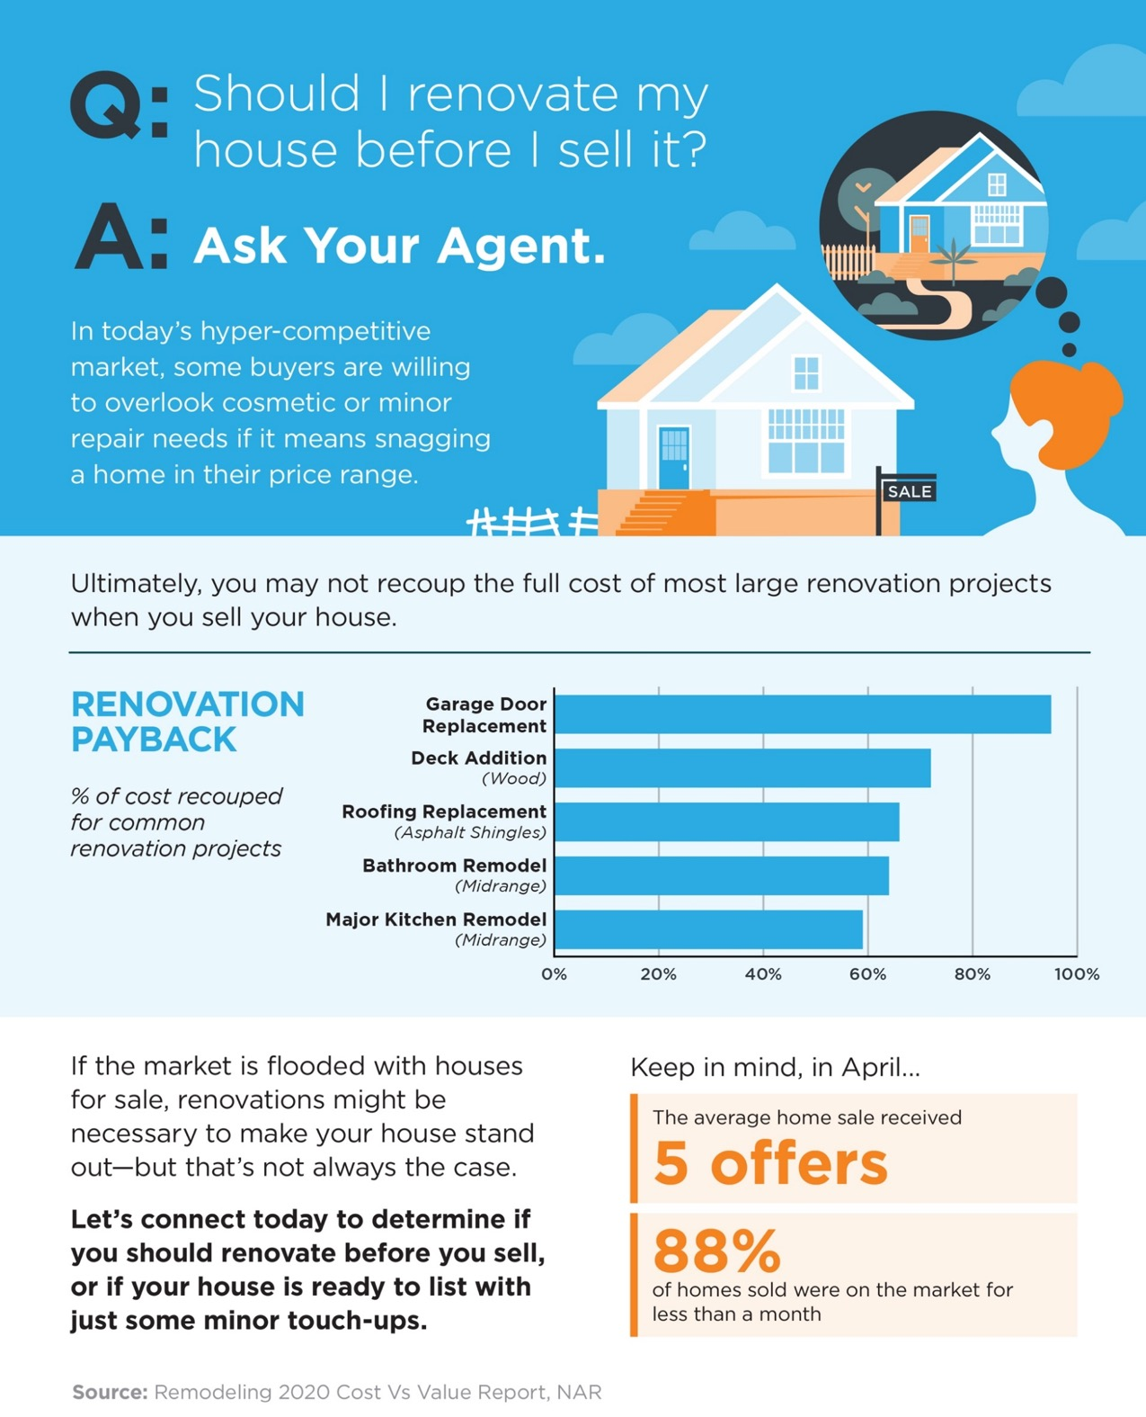
12
Notes:
https://www.metrostudy.com/press/remodeling-magazine-releases-2019-cost-vs-value-report/
https://cdn.nar.realtor/sites/default/files/documents/REALTOR_Confidence_Index_052021.pdf
https://www.nar.realtor/newsroom/existing-home-sales-decline-2-7-in-april

Slide 13
If I Sell Now, Where Will I Go?
Now is clearly a great time to sell, but when you do, how will you find a new home to move into while inventory is so low? With so few homes for sale and construction of newly built homes ramping up, you may be wondering if you should consider new construction in your search process. It’s a great question to ask, and one to look at from the pros and cons of what it means to buy a new home versus an existing one. Here are a few things to consider when making your decision, while always remembering to work with your trusted real estate professional along the way.
Purchasing a Newly Built Home
When buying a new home, you can often choose more energy-efficient options. New appliances, new windows, a new roof, etc. These can all help lower your energy costs, which can add up to significant savings over time. With programs like ENERGY STAR, a new home also helps protect the environment and reduces your carbon footprint.
Lower maintenance that comes with a newer home is another great benefit. When you have a new home, you likely won’t have as many little repairs to tackle, like leaky faucets, shutters to paint, and other odd jobs around the house. With new construction, you’ll also have warranty options that may cover portions of your investment for the first few years.
Another solid benefit to new construction is customization. Do you want a mudroom, stainless steel appliances, granite countertops, hardwood floors, an office, or a multi-purpose room? These items can be customized to your specific needs during the design phase. With an existing home, you’re buying something that’s already completed, so if you want to make changes, you may need to hire a contractor to help get your home ready.
13
Notes:
https://www.energy.gov/eere/buildings/energy-star

Slide 14
Buying an Existing Home
When buying an existing home (one that’s already been built), you can negotiate with the current homeowner on price, which is something you generally don’t get to do with a builder. Builders know their material and construction costs, and they have a price set for the model you’re buying. So, if you want to negotiate, an existing home is likely your best option.
For some buyers, moving into an established neighborhood may be important. If you’d like to get a better sense of things like general traffic patterns in the area and the feel of the community before making a commitment, you might prefer an existing home. When you buy new construction, you won’t always have a full view into some of these details until the lots around you are sold.
Finally, timing comes into play. With an existing home, you can move in based on the timeline you agree to with the sellers, rather than waiting for the house to be built. This is something to keep in mind, especially if you need to move sooner rather than later.
Bottom Line
Whether you want to buy a newly built home or one that’s already established, both are great options. They each have their pros and cons, and every buyer will have different circumstances driving their decision. If you have questions and want to know more about the options in our area, let’s work together so you can feel confident about your next home purchase.
14
Notes:
https://www.cdc.gov/coronavirus/2019-ncov/community/organizations/construction-workers.html

Slide 15
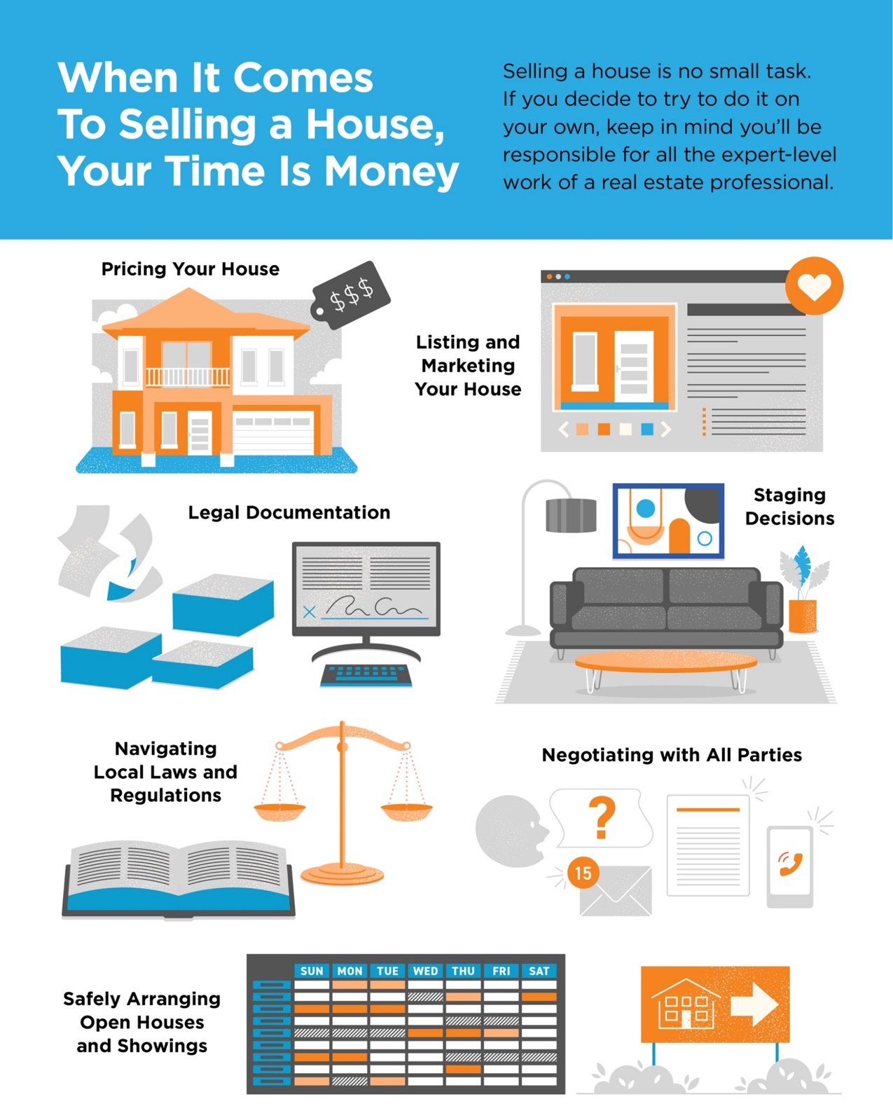
15
Notes:
https://www.nar.realtor/coronavirus-a-guide-for-realtors
https://www.nar.realtor/research-and-statistics/research-reports/home-buyer-and-seller-generational-trends

Slide 16
How Agents Leverage Today’s Technology
Recently, Freddie Mac released a study that analyzes how COVID-19 has impacted the way real estate professionals conduct their business. Roughly half or more of those surveyed report the following changes:
69% provide personal protective equipment (PPE)
55% offer private home tours by appointment
50% assist with remote closings
48% perform virtual showings
With the safety guidelines and technology options recommended by the National Association of Realtors (NAR), real estate agents are well versed in using safe and effective virtual practices and emerging technology throughout the process. So, if you need to sell your house now, what digital options should you use to make sure you and your potential buyers stay safe throughout the process?
Working with a trusted professional who’s skilled with today’s changing technology may help you win big. While always abiding by state and local regulations, agents know exactly what today’s buyers need, and how to put the necessary digital steps in place. Here are some options they may offer:
Virtual tour of the home
Accurate and detailed listing information
Detailed neighborhood information
High-quality listing photos
Agent-led video chat
When it’s time to show your house in person, agents are also able to regulate the process, based on the recommendations given by NAR, to help you proceed safely. Here are a few of the guidelines, understanding the top priority should always be to obey state and local restrictions first:
Limit in-person activity
Require guests to wash their hands or use an alcohol-based sanitizer
Remove shoes or cover with booties
Follow CDC guidance on social distancing and wearing face coverings
Bottom Line
In this era of life, things are shifting quickly, so virtual seller strategies may be a game-changing option for you. Let’s connect so you can safely and effectively navigate through all that’s evolving when it comes to making your next move.
16
Notes:
http://images.infofreddiemac.com/Web/FreddieMac/%7B129012f0-f54d-41b2-88e2-a12f1fbd1063%7D_Real_Estate_Association_2020_Research_Report_Published.pdf
https://www.nar.realtor/coronavirus-a-guide-for-realtors%C2%AE

Slide 17
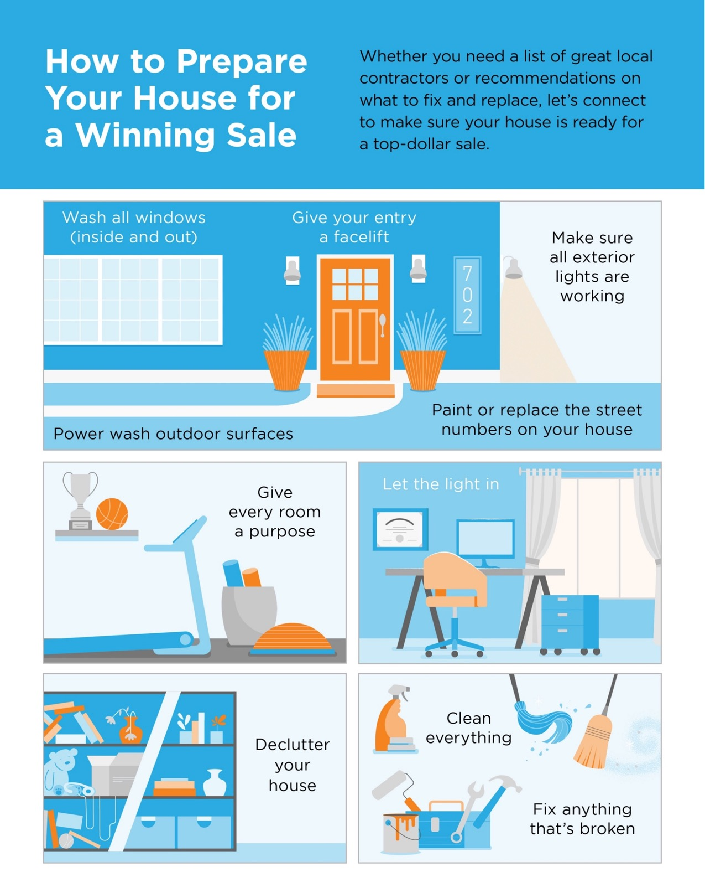
17

Slide 18
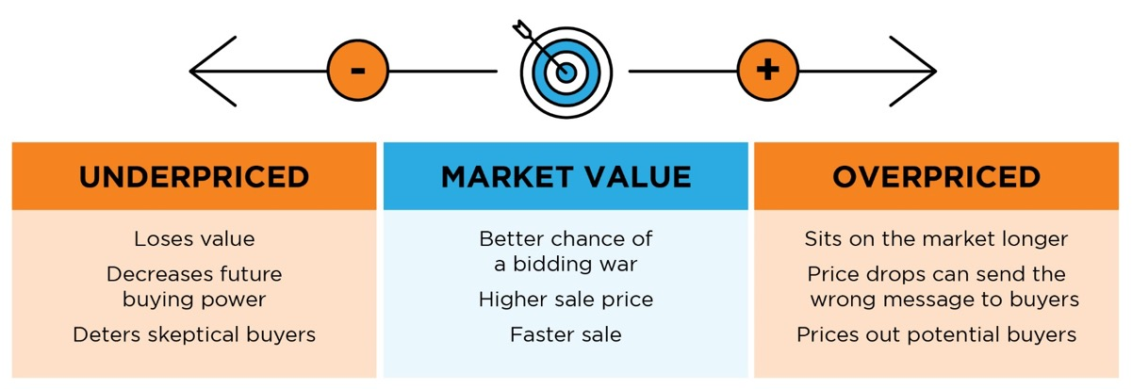
Why Pricing Your House Right Matters
In today’s real estate market, setting the right price for your house is one of the most valuable things you can do. According to an average of leading expert projections, existing home prices nationwide are expected to increase by 7.1% this year. This means experts anticipate home values will continue climbing going forward. When it comes to pricing your house, the goal is to increase visibility and drive more buyers your way. Instead of trying to win the negotiation with one buyer, you should price your house so demand is maximized, and more buyers want to take a look.
As a seller, you might be thinking about pricing your house on the high end while so many of today’s buyers are searching harder than ever just to find a home to purchase. But here’s the thing – a high price tag does not mean you’re going to cash in big on the sale. It’s actually more likely to deter buyers.
Even today, when there are so few houses for sale, your house is more likely to sit on the market longer or require a price drop that can send buyers running if it isn’t set just right.
It’s important to work with a trusted real estate professional to make sure your house is priced correctly. When you price it competitively, you won’t be negotiating with one buyer. Instead, you’ll likely have multiple buyers competing for it, potentially increasing the final sale price.
Bottom Line
The key is to make sure your house is priced to sell immediately. This way, it will be seen by the most buyers. More than one of them may be interested, and it will be more likely to sell at a competitive price. Let’s work together to price your house correctly from the start so you can maximize your exposure and return.
18
Notes:
https://www.mba.org/news-research-and-resources/research-and-economics/forecasts-and-commentary
https://www.fanniemae.com/media/38961/display
https://www.zelmanassociates.com/ (suscription required)
https://cdn.nar.realtor/sites/default/files/documents/2021-05-13-realtors-legislative-meetings-residential-economic-issues-and-trends-forum-lawrence-yun-presentation-slides-05-13-2021.pdf
http://www.freddiemac.com/research/forecast/20210414_quarterly_economic_forecast.page?
https://www.realtor.com/research/2021-national-housing-forecast/
https://www.corelogic.com/insights-download/home-price-index.aspx
https://www.nar.realtor/research-and-statistics
https://cdn.nar.realtor/sites/default/files/documents/forecast-Q1-2021-us-economic-outlook-01-30-2021.pdf

Slide 19
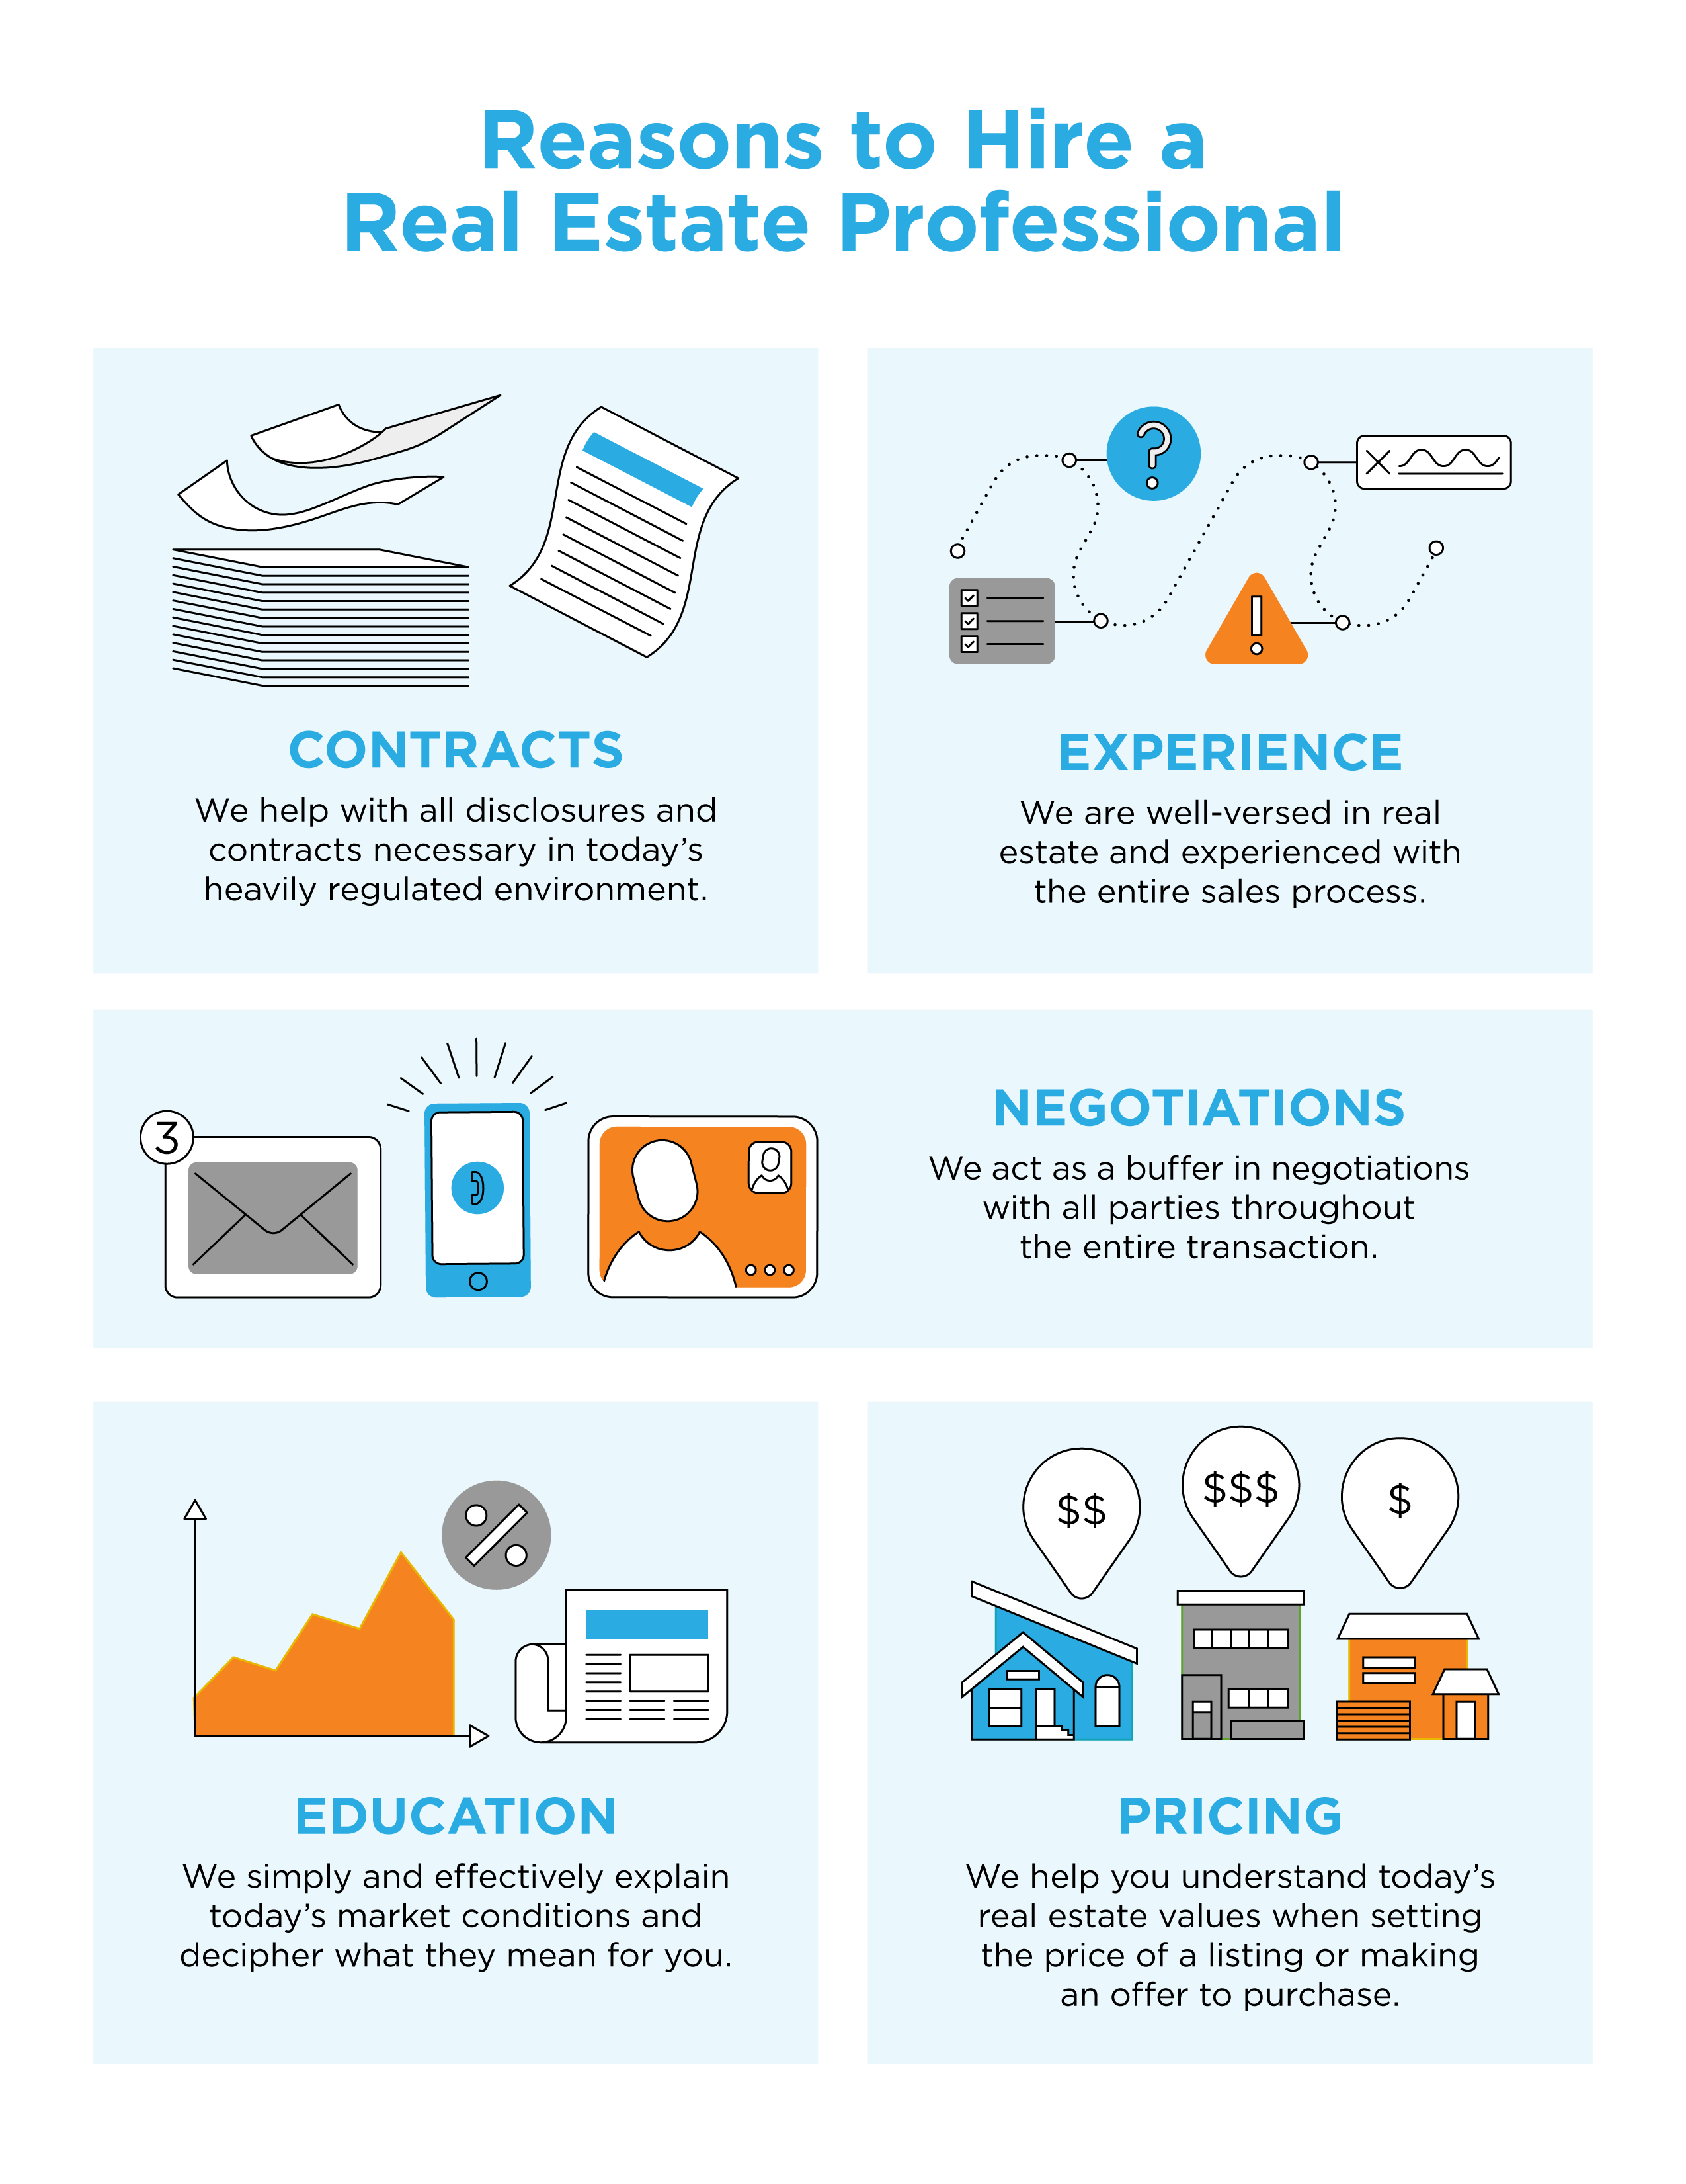
19

Slide 20
CONTACT ME TO TALK MORE
I’m sure you have questions and concerns about the real estate process. I’d love to talk with you about what you read here, as well as help you on the path to selling your house. My contact information is below, and I look forward to working with you.
Sep Ebrahimi REALTOR®
Broker Associate
"Top 1% Nationwide - Chairman's Circle Platinum Award Winner"
"Yes! I am Relocation Certified!"
Direct: (310) 346-4666 www.SepSellsPV.com
Equal Housing Opportunity

